Slide 1
IBM CNOT GATE 仿真
制作人： 李少炜
时间：2017.11.12

Slide 2
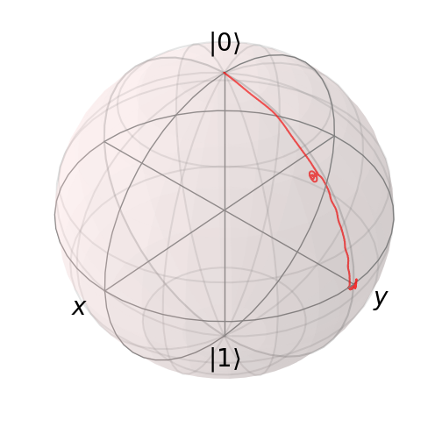
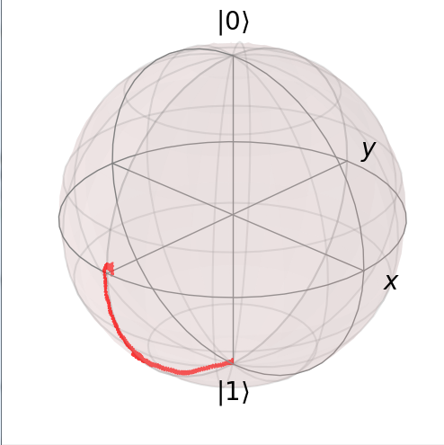
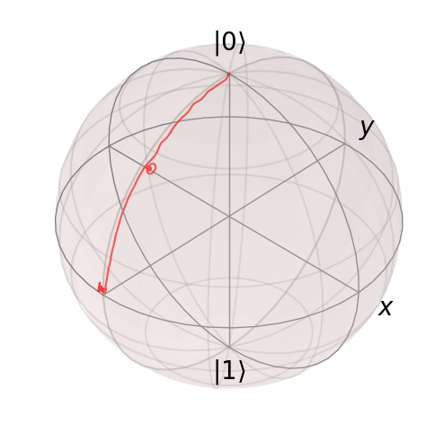
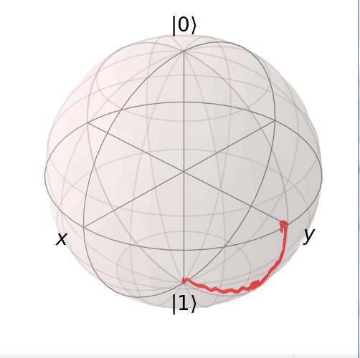
加入驱动后，00与01耦合形成新的能量本征态0+，0-，E(0+)>E(0-)
转动频率E(0+)-E(0-)
加入驱动后，10与11耦合形成新的能量本征态1-，1+，E(1-)>E(0+)）
转动频率E(1-)-E(1+)

Slide 3
原理分析（注：由于编排没协调好，本节control和target顺序对调）
哈密顿量（1：target；2：control）

Slide 4
旋波近似

Slide 6
间接耦合简要分析

Slide 7
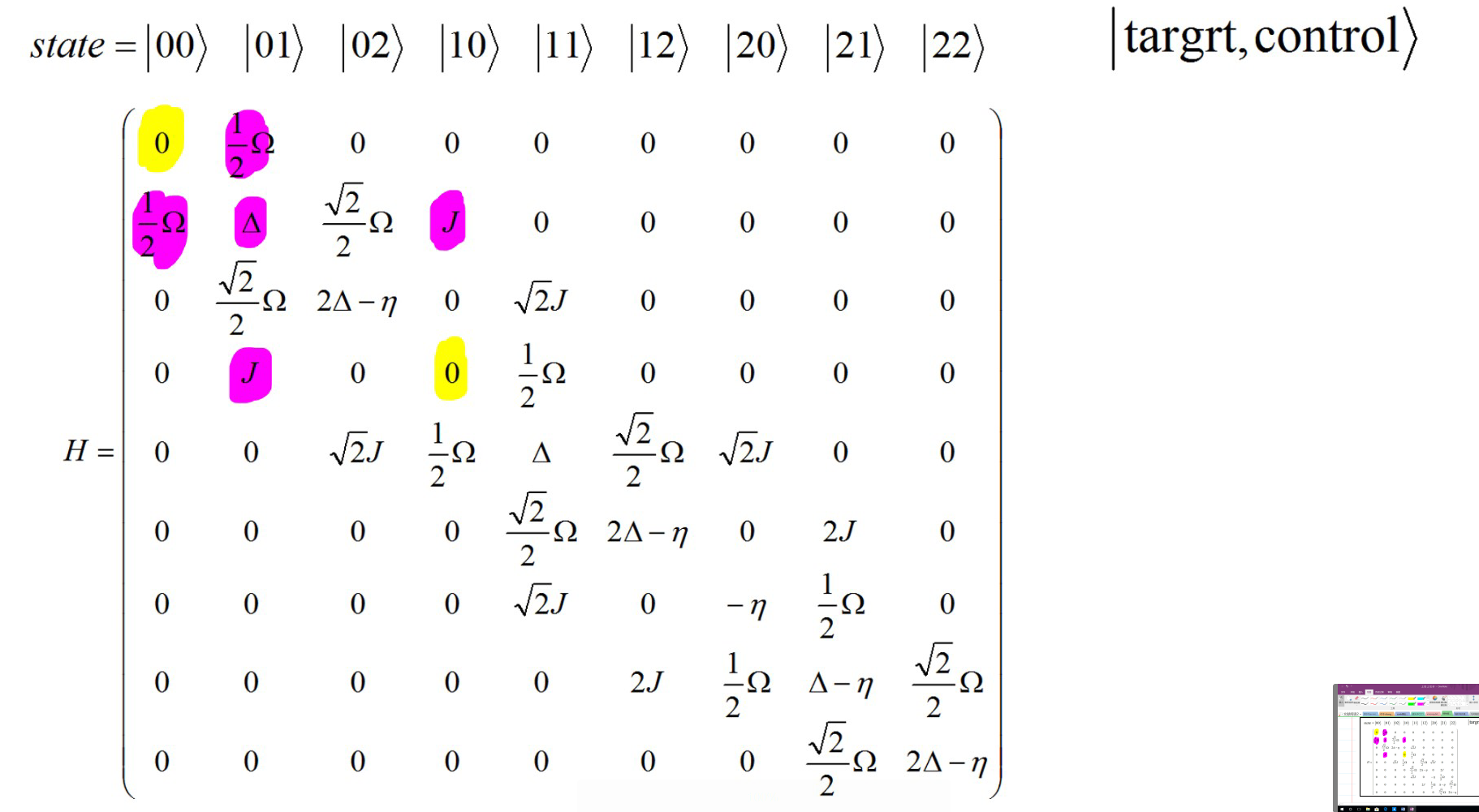
00与10之间的耦合示意图

Slide 8
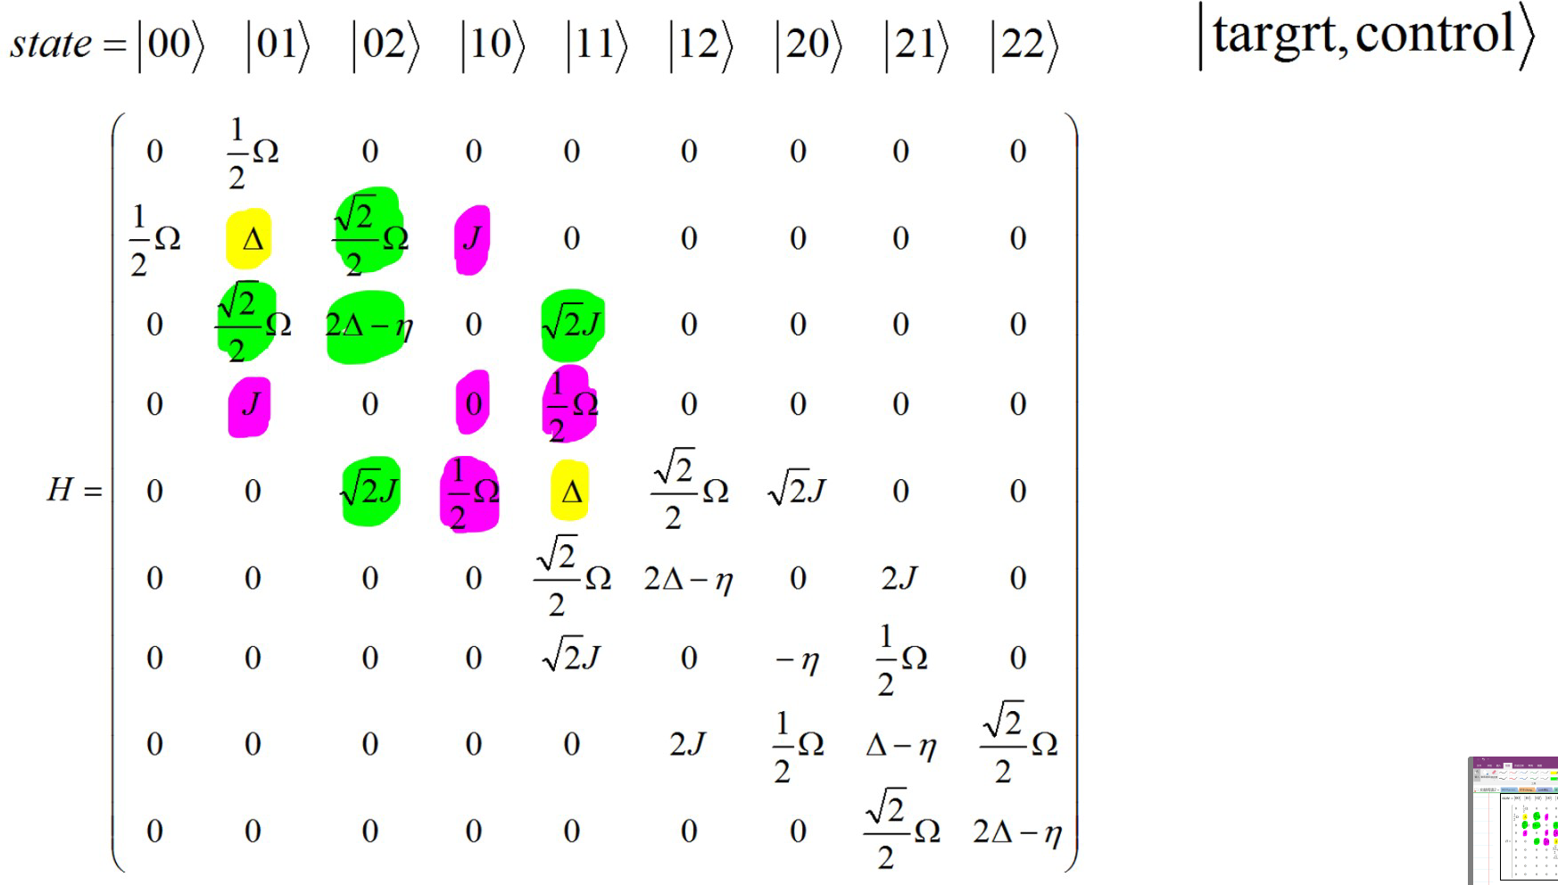
01与11之间的耦合示意图

Slide 9
黄紫部分(10为媒介)
黄绿部分(02为媒介)

Slide 10
哈密顿矩阵数值解
由于耦合项比较复杂，准确的分析需要数值解。
按照IBM实验方案：
代入参数：

Slide 13
尝试IBM参数
耦合项：tensor(a+a.dag(),a+a.dag())（比特和腔之间）
驱动项：a+a.dag()
t_gate=(57+40+57+40)ns=180ns
drive_amp=60.5M（引入高斯包络，能量轴偏移近似绝热）
coupling_strength=83M（腔和比特之间）
delta=w_control-w_target=200M
（参数手动优化）
X门加入drag，target qubit加入校正波形
文件：IBM_CNOT_Simulation(4).py

Slide 14
fidelity and phase of 4 basis and '++','00+11'
without compensate
with compensate
state(control,target) | 00 | 01 | 10 | 11
fidelity | 0.99700 | 0.99465 | 0.9915 | 0.99253
phase | -142.689 | -147.975 | 34.668 | 22.215
fidelity q_control | 0.99585 | 0.99316 | 0.98413 | 0.98879
fidelity q_target | 0.99630 | 0.99797 | 0.99540 | 0.99444
++ | 00+11
0.99415 | 0.99524
-142.813 | -144.55
0.99215 | 0.99520
0.99443 | 0.99609
phase compensate
state | 0 | 1 | delta | target
0 | -142.689 | -147.975 | -5.286 | -8.870
1 | 34.668 | 22.215 | -12.453
delta | 177.357 | 170.190
control | 173.774
after compensate
state | 0 | 1
0 | -142.689 | -139.105
1 | -139.106 | -142.689

Slide 15
二能级系统近似(非绝热驱动)
耦合项：tensor(sigmax,sigmax)
驱动项：sigmax
sigmax=[0 1 0;1 0 0; 0 0 0]
t_gate=450ns
drive_amp=60M
coupling_strength=3.8M

Slide 16
fidelity and phase of 4 basis(without compensate)
state(control,target) | 00 | 01 | 10 | 11
fidelity(rotate) | 0.99988 | 0.99988 | 0.99670 | 0.99770
phase(rotate) | -7.683 | 98.708 | 118.567 | 228.554
fidelity(norm) | 0.97973 | 0.97970 | 0.97549 | 0.97891
fidelity q_control(rotate) | 0.99995 | 0.99997 | 0.99995 | 0.99993
fidelity q_target(rotate) | 0.99978 | 0.99977 | 0.99343 | 0.99543
phase compensate
state | 0 | 1 | delta | target
0 | -7.683 | 98.708 | 106.391 | 108.189
1 | 118.567 | 228.554 | 109.897
delta | 126.250 | 129.846
control | 128.048
after compensate
state | 0 | 1
0 | -7.683 | -9.481
1 | -9.481 | -7.683

Slide 17
fidelity and phase of 4 basis(with compensate)
state(control,target) | 00 | 01 | 10 | 11 | ++ | 00+11
fidelity(rotate) | 0.99988 | 0.99988 | 0.99670 | 0.99770 | 0.99607 | 0.99533
phase(rotate) | -7.683 | -9.481 | -9.481 | -7.683 | -8.624 | -8.096
fidelity(norm) | 0.97973 | 0.97970 | 0.97549 | 0.97891 | 0.28710 | 0.47828
fidelity q_control(rotate) | 0.99995 | 0.99997 | 0.99995 | 0.99993 | 0.99398 | 0.99211
fidelity q_target(rotate) | 0.99978 | 0.99977 | 0.99343 | 0.99543 | 0.99474 | 0.99715
after compensate
state | 0 | 1
0 | -7.683 | -9.481
1 | -9.481 | -7.683

Slide 18
含腔三能级系统
耦合项：tensor(a+a.dag(),a+a.dag())（比特和腔之间）
驱动项：a+a.dag()
t_gate=(175+25+175+25)ns
drive_amp=60M（引入高斯包络，能量轴偏移近似绝热）
coupling_strength=100M（腔和比特之间）
delta=w_control-w_target=-200M
（参数手动优化）
文件：IBM_CNOT_Simulation(1).py

Slide 19
fidelity and phase of 4 basis and '++','00+11'
without compensate
with compensate
state(control,target) | 00 | 01 | 10 | 11
fidelity | 0.9926 | 0.9892 | 0.9906 | 0.9849
phase | -48.07 | -96.53 | 163.40 | 123.80
fidelity q_control | 0.9883 | 0.9893 | 0.9842 | 0.9802
fidelity q_target | 0.9949 | 0.9944 | 0.9927 | 0.9864
++ | 00+11
0.9922 | 0.9917
-45.41 | -43.28
0.9947 | 0.9904
0.9909 | 0.9882
phase compensate
state | 0 | 1 | delta | target
0 | -48.07 | -96.53 | -48.46 | -44.03
1 | 163.40 | 123.80 | -39.60
delta | 211.47 | 220.33
control | 215.90
after compensate
state | 0 | 1
0 | -48.07 | -52.50
1 | -52.50 | -48.07

Slide 20
增大耦合强度减小门时间
耦合项：tensor(a+a.dag(),a+a.dag())（比特和腔之间）
驱动项：a+a.dag()
t_gate=(100+30+100+30)ns=260ns
drive_amp=60M（引入高斯包络，能量轴偏移近似绝热）
coupling_strength=100M（腔和比特之间）
delta=w_control-w_target=-200M
（参数手动优化）
文件：IBM_CNOT_Simulation(2).py

Slide 21
fidelity and phase of 4 basis and '++','00+11'
without compensate
with compensate
state(control,target) | 00 | 01 | 10 | 11
fidelity | 0.98958 | 0.98942 | 0.98397 | 0.98118
phase | 85.275 | 37.141 | 146.994 | 96.125
fidelity q_control | 0.98263 | 0.98204 | 0.97294 | 0.96455
fidelity q_target | 0.99503 | 0.98580 | 0.98561 | 0.98275
++ | 00+11
0.98885 | 0.99027
79.650 | 78.847
0.98613 | 0.98516
0.98941 | 0.98806
phase compensate
state | 0 | 1 | delta | target
0 | 85.275 | 37.141 | -48.134 | -50.502
1 | 146.994 | 94.125 | -52.869
delta | 61.719 | 56.984
control | 59.352
after compensate
state | 0 | 1
0 | 85.275 | 87.643
1 | 87.642 | 85.275

Slide 22
尝试IBM参数
耦合项：tensor(a+a.dag(),a+a.dag())（比特和腔之间）
驱动项：a+a.dag()
t_gate=(57+40+57+40)ns=180ns
drive_amp=60.5M（引入高斯包络，能量轴偏移近似绝热）
coupling_strength=83M（腔和比特之间）
（参数手动优化）
X门加入drag，control qubit和target qubit交换（转动加速），target qubit加入校正波形
文件：IBM_CNOT_Simulation(4).py

Slide 23
fidelity and phase of 4 basis and '++','00+11'
without compensate
with compensate
state(control,target) | 00 | 01 | 10 | 11
fidelity | 0.99700 | 0.99465 | 0.9915 | 0.99253
phase | -142.689 | -147.975 | 34.668 | 22.215
fidelity q_control | 0.99585 | 0.99316 | 0.98413 | 0.98879
fidelity q_target | 0.99630 | 0.99797 | 0.99540 | 0.99444
++ | 00+11
0.99415 | 0.99524
-142.813 | -144.55
0.99215 | 0.99520
0.99443 | 0.99609
phase compensate
state | 0 | 1 | delta | target
0 | -142.689 | -147.975 | -5.286 | -8.870
1 | 34.668 | 22.215 | -12.453
delta | 177.357 | 170.190
control | 173.774
after compensate
state | 0 | 1
0 | -142.689 | -139.105
1 | -139.106 | -142.689

Slide 24
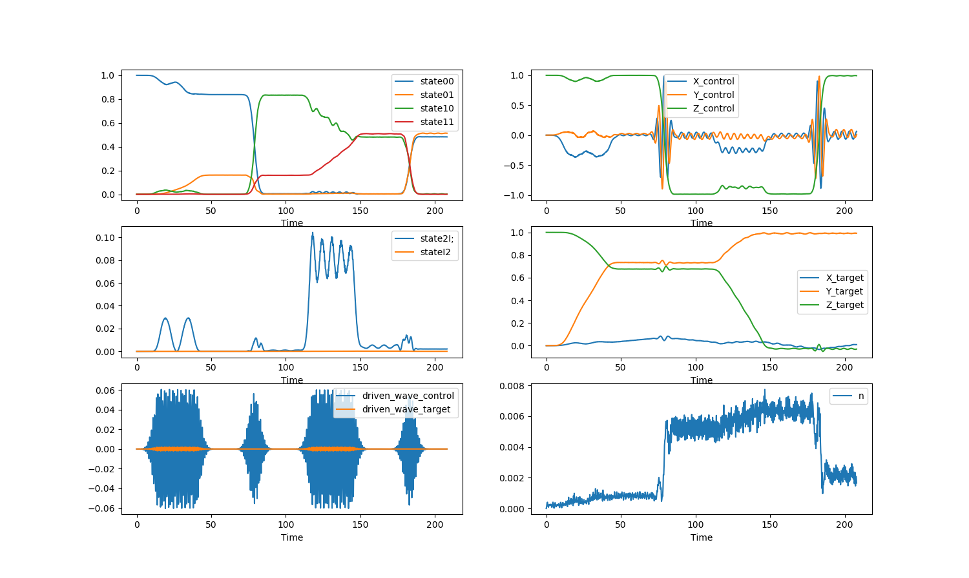
psi0:00

Slide 25
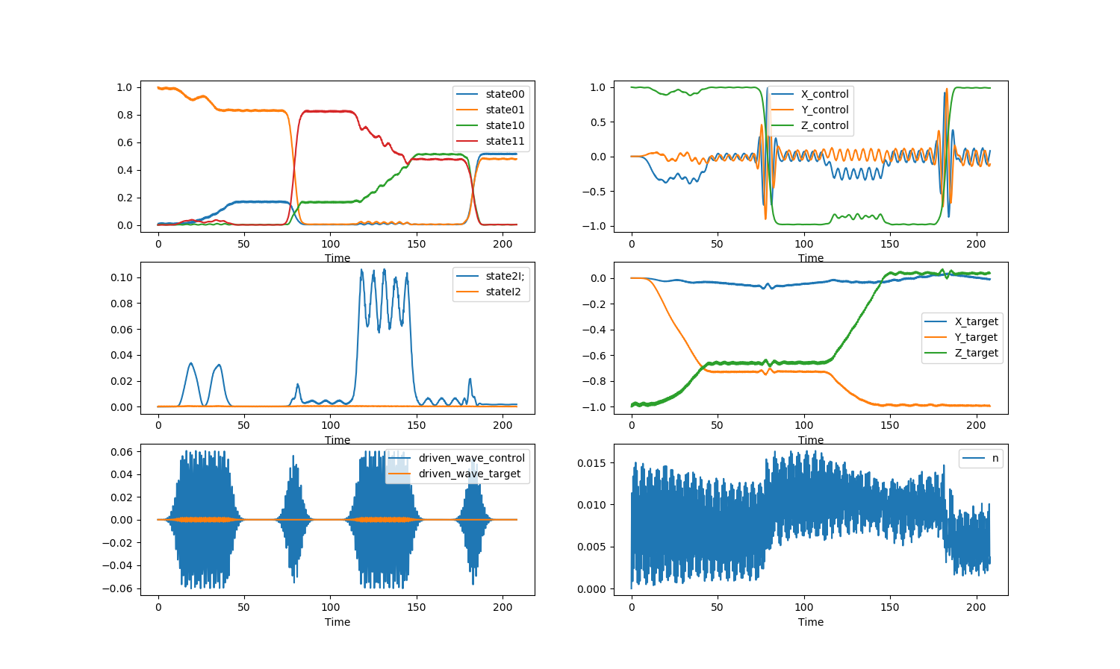
psi0:01

Slide 26
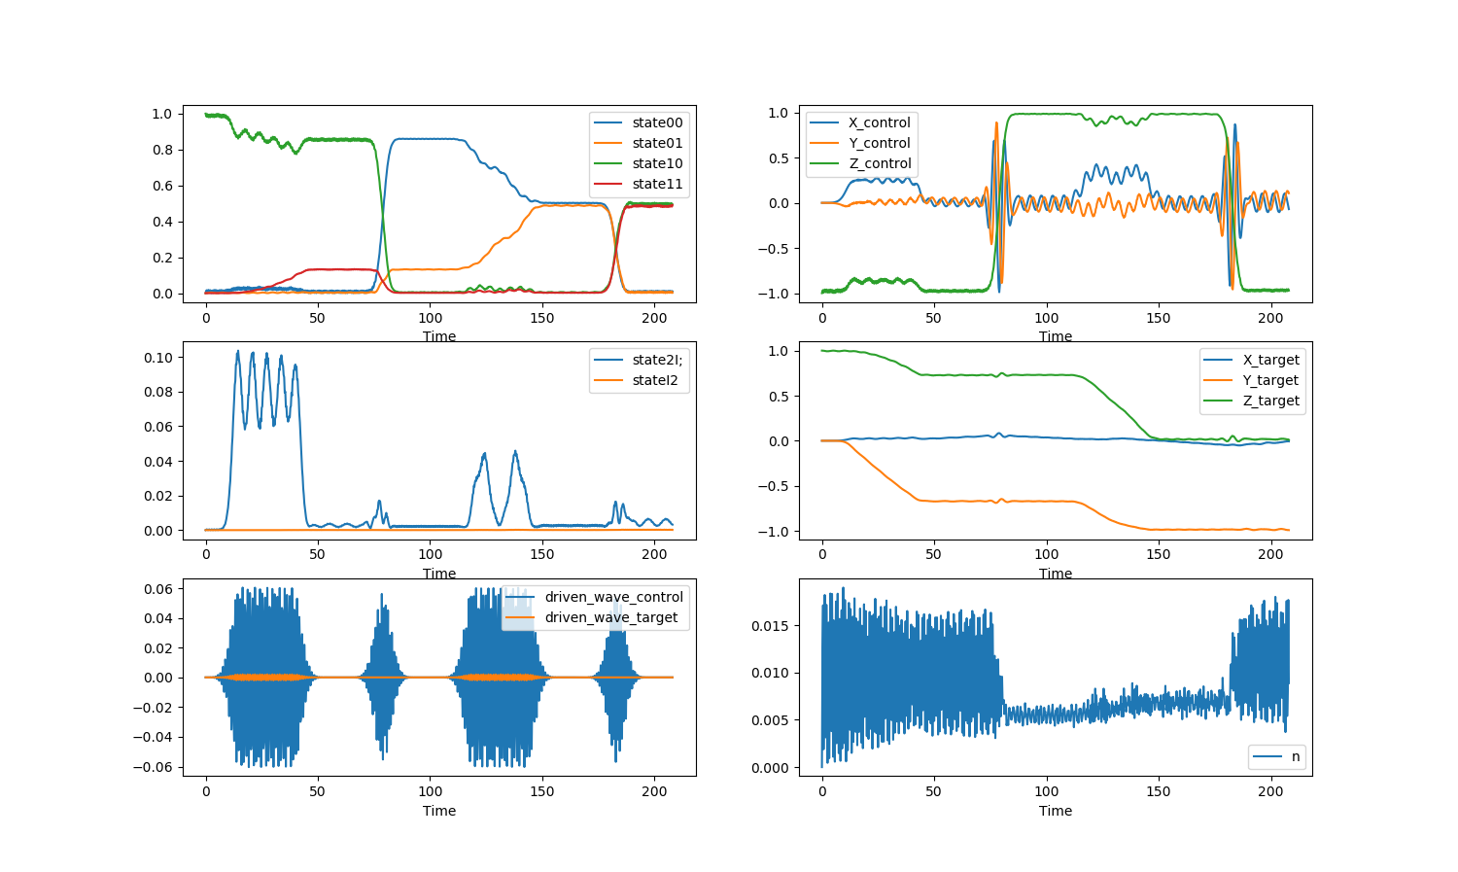
psi0:10

Slide 27
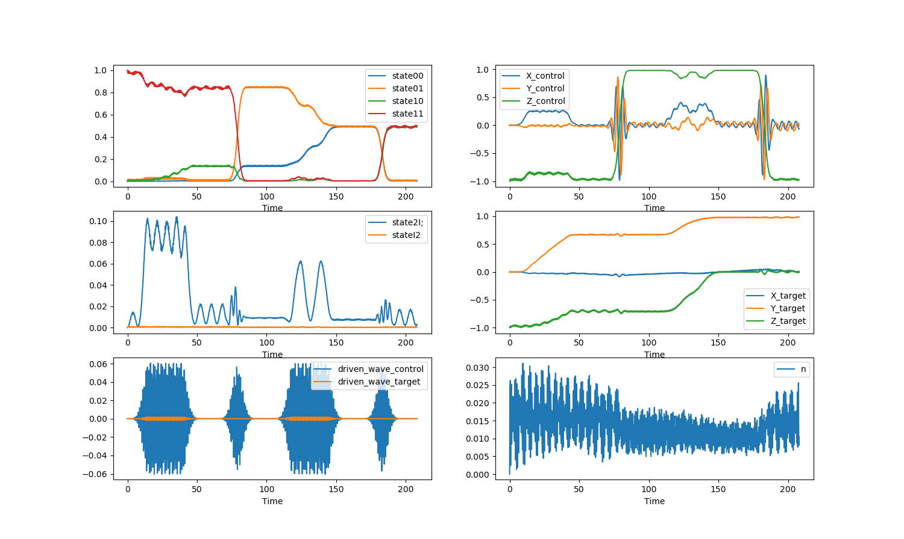
psi0:11

Slide 28
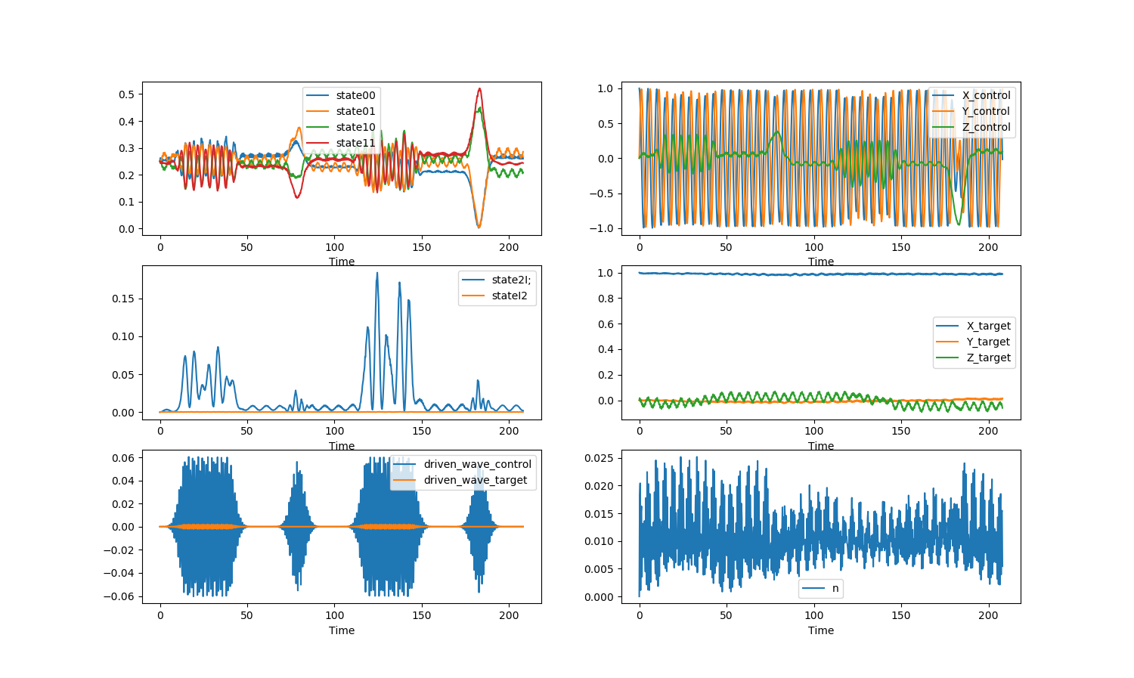
psi0:++

Slide 29
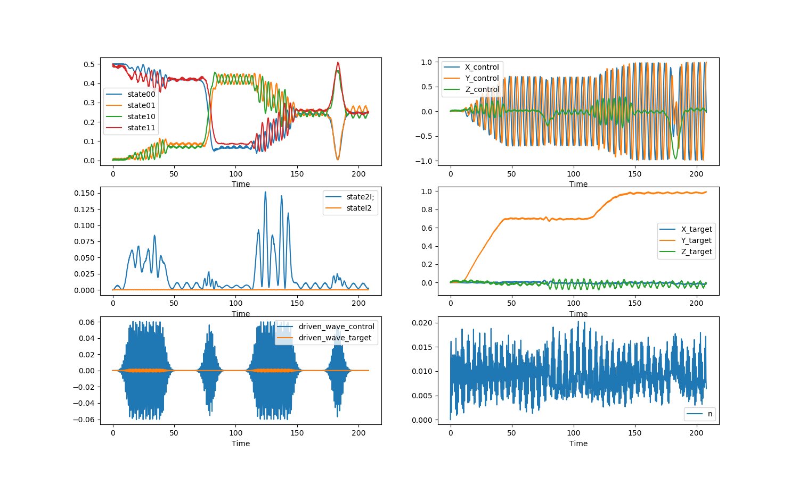
psi0:00+11

